Slide 1
2024 Fall Recruitment Social Image
Story 1080 x 1920
Powerpoint Template
HOW TO USE
After customizing the templates, go to: File > Save as > JPG image > Current slide
#CubScouts #CubScoutFun
www.ScoutingAZ.com

Slide 2
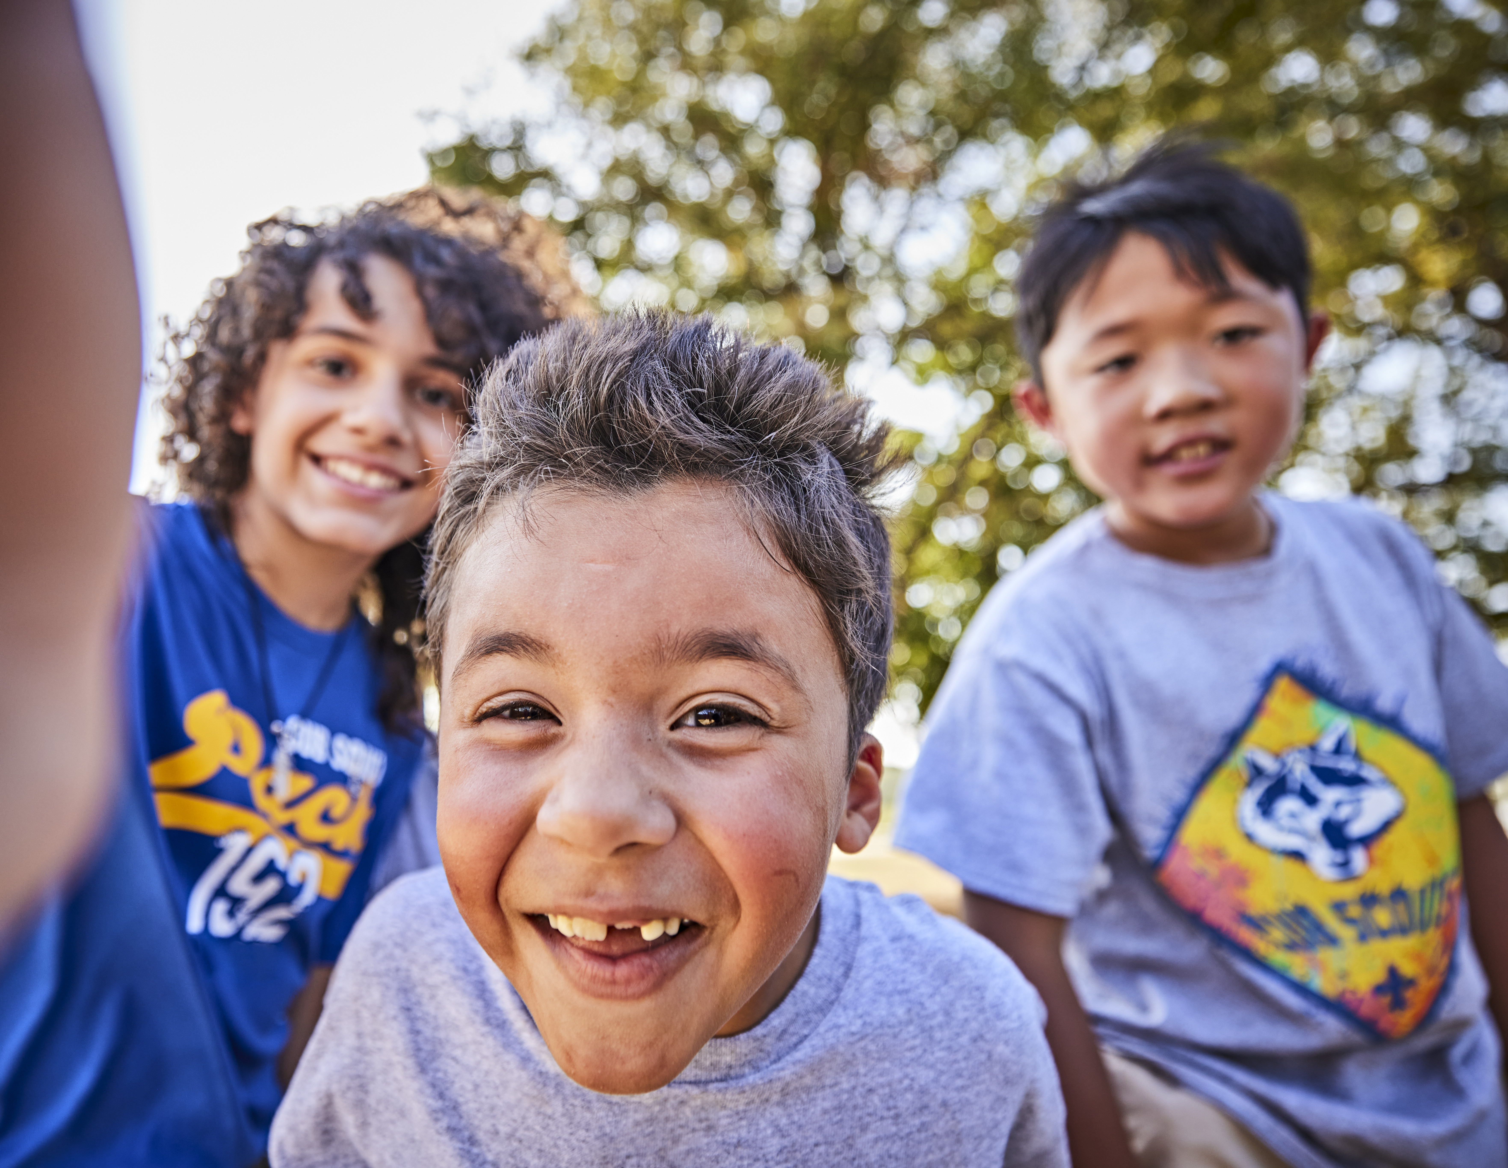
Cub Scouting is fun
with friends in the
great outdoors!
Cub Scouting is fun with friends in the great outdoors!
It’s camping, crafts, pinewood derby cars,
hands-on learning, &
much more!

Slide 3
Cub Scouting is fun
with friends in the
great outdoors!
It’s camping, crafts, pinewood derby cars,
hands-on learning, &
much more!

Slide 4
Cub Scouting es diversion con amigos al aire libre!
Campamentos, artesanias, pinewood derby autos, aprendizaje practico, y mucho mas

